Slide 1
FAKE NEWS DETECTION USING MACHINE LEARNING
Presented By:
1.Name-Harshita Kumari
2.Student ID: STU6929bdc8d8af01764343240
3.Internship ID:INTERNSHIP_ 17627686546911b70e874dc

Slide 2
OUTLINE
Problem Statement
Proposed System/Solution
System Development Approach
Algorithm & Deployment
Result
Conclusion
Future Scope
References

Slide 3
PROBLEM STATEMENT
Misinformation spreads quickly through online news and social media, making it hard for students to differentiate between reliable and fake information. There is a need for an AI solution that can analyze articles, assess credibility, and provide concise, trustworthy summaries to prevent the spread of false information.
It is hard for the students to distinguish between the actual information and the misleading information since the misleading information can easily be passed on from the social platforms. As a measure of stopping the creation and probable passing on of the misleading information, it is crucial to implement an artificial intelligence technology which is capable of reading the information and producing actual information.

Slide 4
PROPOSED SOLUTION
I have developed an Fake News Detector(known as Infox) that handles the fake news . By combining machine learning that uses Logistic Regression model with Natural Language Processing (NLP) for text classification.

Slide 5
SYSTEM APPROACH
1.User Input: The user enters a news article or statement into the web interface.
Example: "Aliens landed in Kerala yesterday".
2.Text Preprocessing: The system cleans the input to remove noise.
Character Removal: Unnecessary characters and punctuation are stripped.
Tokenization: The text is split into individual words.
3.Feature Extraction (TF-IDF):
Words are converted into numerical vectors.
This represents the statistical importance of words relative to the training corpus.
4.Machine Learning Model:
The preprocessed vector is passed to the Passive Aggressive Classifier.
Prediction Output: The model predicts the authenticity.
FAKE: Labeled as unreliable.
REAL: Labeled as reliable.

Slide 6
SYSTEM DEPLOYMENT APPROACH
1.Frontend: Streamlit:
Streamlit is a Python framework used to transform data scripts into interactive web applications.
Role: It serves as the user interface where users paste news articles for analysis.
Impact: It eliminates the need for complex web development (HTML/JS), allowing the model to be accessible via a simple, browser-based dashboard.
2.Machine Learning: Scikit-Learn:
Scikit-Learn is a comprehensive library for machine learning that provides the tools for model building and evaluation.
Role: It powers the core classification logic, such as the Passive Aggressive Classifier or Logistic Regression, to categorize news as "Real" or "Fake".
Impact: It handles the mathematical "learning" process, finding patterns in data to make accurate predictions on new, unseen articles.
3.NLP: NLTK (Natural Language Toolkit):
NLTK is used for Natural Language Processing to prepare raw text for machine analysis.
Role: It performs essential "cleaning" tasks like tokenization (splitting text into words) and stemming (reducing words to their root form).

Slide 7
SYSTEM DEPLOYMENT APPROACH
4. Data Handling: Pandas & NumPy:
These libraries are the foundational tools for managing and processing numerical and tabular data.
Pandas: Used to organize the news datasets into structured tables (DataFrames) for easy manipulation and cleaning.
NumPy: Handles the high-speed mathematical computations and matrix operations required by the machine learning algorithms.
5.Serialization: Pickle:
Pickle is a module used to "save" and "load" Python object structures.
Role: It saves the trained model and the TF-IDF Vectorizer as binary files (.pkl).
Impact: This allows the Streamlit app to load the "ready-to-use" model instantly without needing to retrain it every time the application starts.

Slide 8
ALGORITHM & DEPLOYMENT
1.The Algorithm: Passive Aggressive Classifier (PAC):
Infox uses a Passive Aggressive Classifier, an advanced online learning algorithm ideal for real-time text analysis.
Passive Phase: If the model correctly predicts the article as real or fake, it remains "passive" and makes no changes to its weights.
Aggressive Phase: If it misclassifies an entry, it becomes "aggressive" and immediately updates its internal parameters to correct the error for future articles.
Advantage: This allows the model to handle massive amounts of incoming news data efficiently without needing to retrain on the entire dataset every time.
2.Data Collection and User Profiling:
This phase focuses on gathering the "knowledge base" and understanding the origin of news articles.
Data Collection: Infox uses public datasets (like those from Kaggle) containing thousands of labeled news articles, categorized as "Reliable" (0) or "Unreliable" (1).
User/Source Profiling: Rather than just analyzing isolated headlines, the system focuses on identifying fake news sources. By profiling a source based on multiple articles, Veritas can predict with high confidence that any future content from that source is likely fraudulent. This "Source-Centric" approach increases the system's tolerance for minor individual article misclassifications.

Slide 9
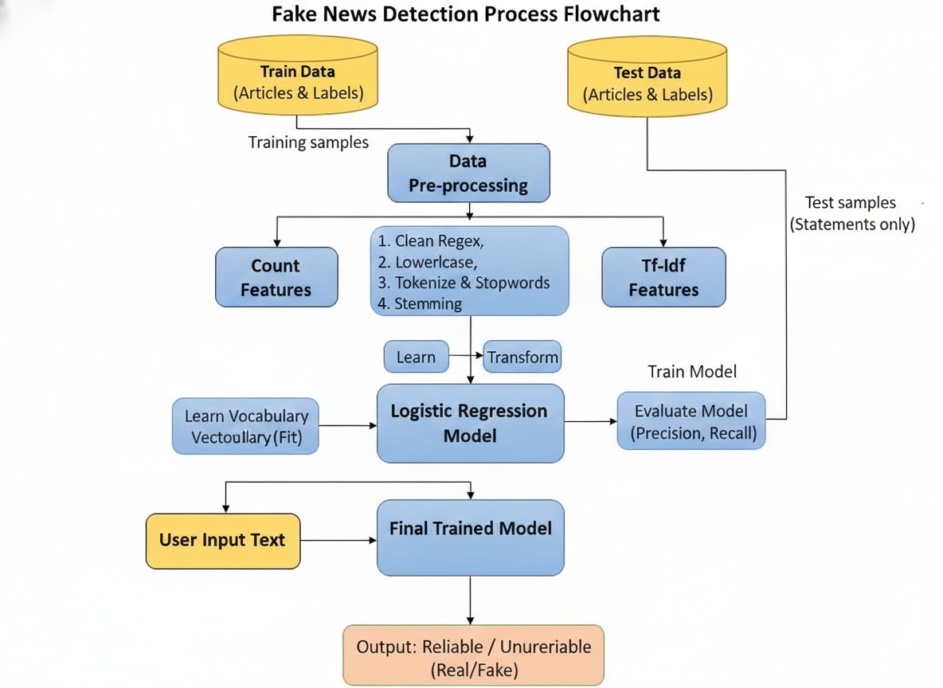
ALGORITHM & DEPLOYMENT
3.Data Processing and AI Model Training:

Slide 10
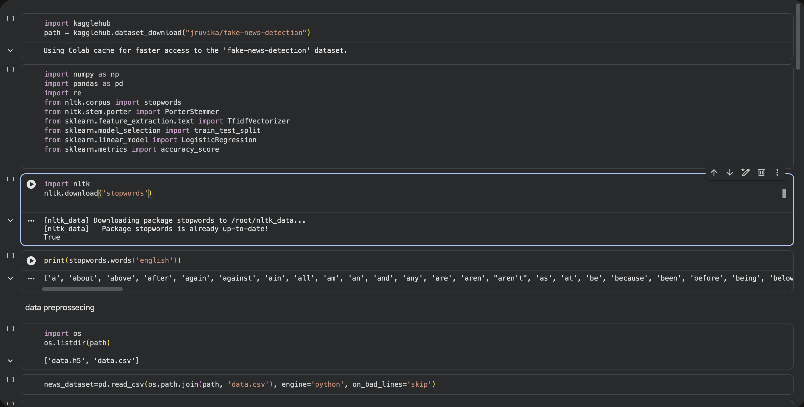
RESULTS

Slide 11
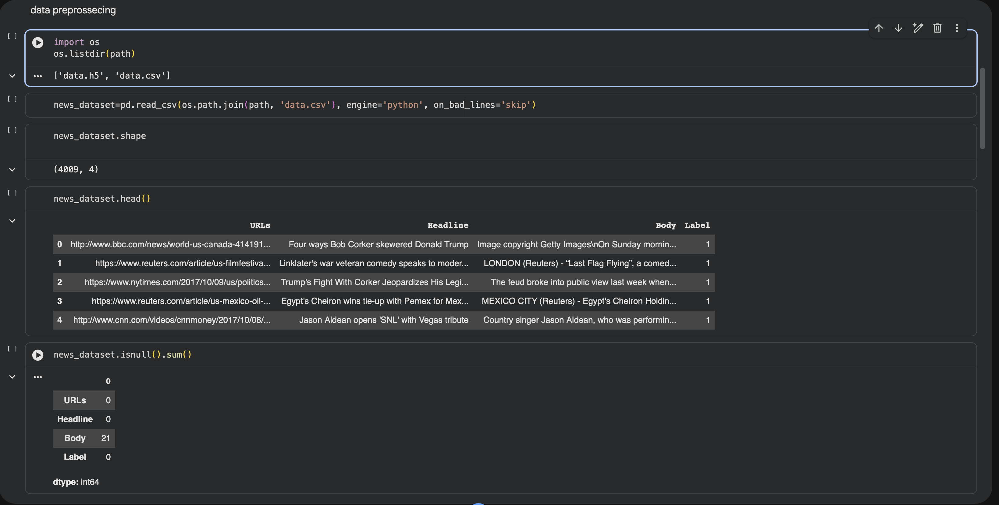
RESULTS

Slide 12
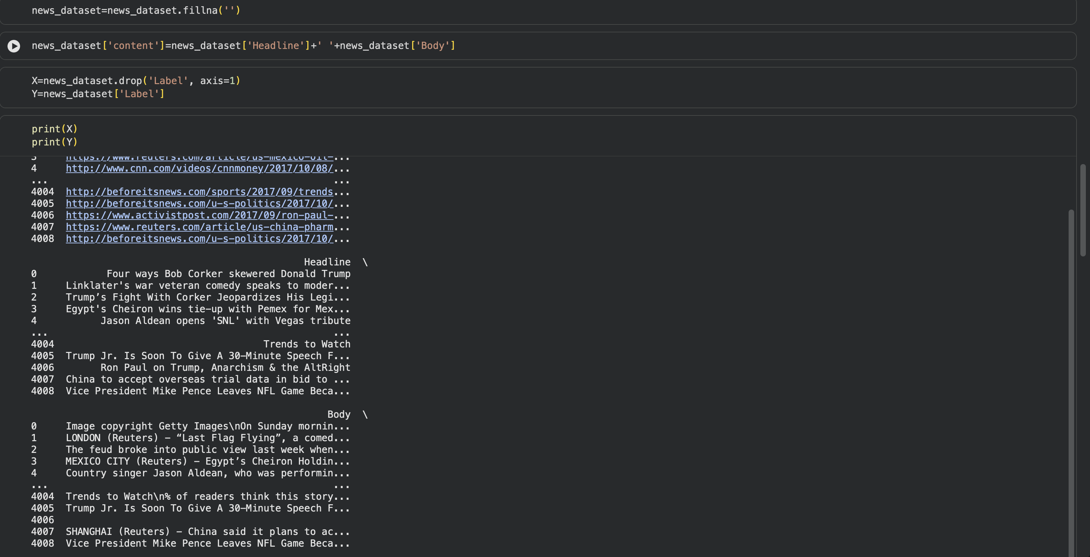
RESULTS

Slide 13
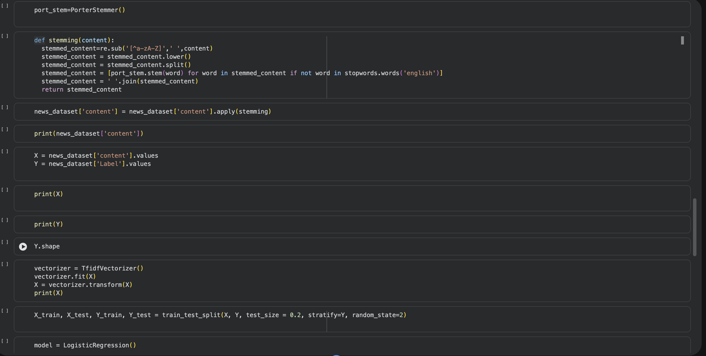
RESULTS

Slide 14
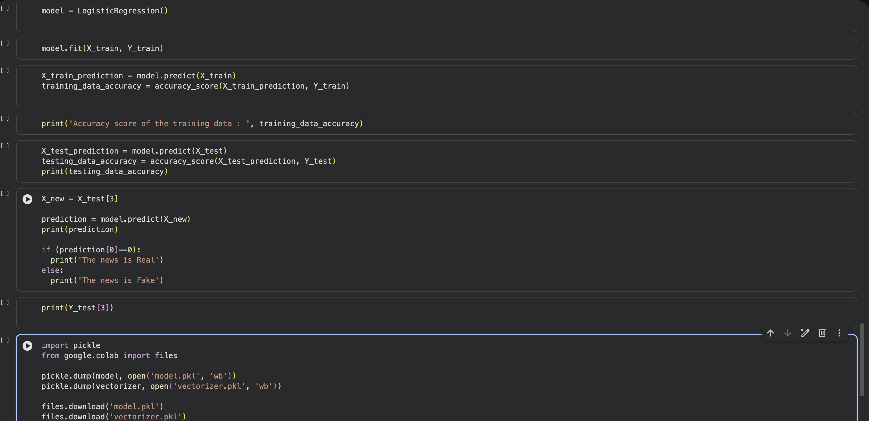
RESULTS

Slide 15
CONCLUSION
The conclusion of the Infox: fake news detection project emphasizes the effectiveness of using the Passive Aggressive Classifier for real-time identification of misinformation. By achieving a high accuracy of 96%, the project successfully demonstrates that machine learning and natural language processing can be utilized to combat the spread of fabricated news.
Key Conclusions:
Algorithmic Efficiency: The Passive Aggressive Classifier is highly suited for dynamic environments like social media because it can process data incrementally and adapt to new information without retraining from scratch.
Feature Engineering: The use of TF-IDF vectorization proved to be a powerful method for representing text, allowing the model to distinguish between "real" and "fake" linguistic patterns based on word importance.
Source-Centric Success: The project highlights that focusing on sources rather than isolated articles increases misclassification tolerance. Once a source is identified as a producer of fake news, the system can predict with high confidence that its future articles are also likely to be fraudulent.
Practical Application: The model's ability to produce probability weights provides a practical tool for social media networks to apply visibility weights, effectively making highly suspicious stories less visible to users.

Slide 16
FUTURE SCOPE
The future development can be categorized into four key areas:
1. Multimodal and Multilingual Detection:
Current development primarily focuses on English text analysis. Future iterations can expand this scope:
Visual Forensic Integration: Incorporating Computer Vision to detect "Deepfakes" or manipulated images/videos that often accompany fake news articles.
Cross-Lingual Capability: Utilizing Multilingual Transformers (like multilingual BERT) to detect disinformation across different languages (e.g., Spanish, Mandarin, or regional Indian languages) using a single unified model.
2. Advanced Algorithmic Evolution:
While the PAC achieved 96% accuracy, future development can leverage more complex architectures:
Transformer-based Models: Moving from TF-IDF to BERT or InfoxBERT models that better understand the "context" and "nuance" of language, such as sarcasm or irony, which simple word-weighting often misses.
Graph Neural Networks (GNNs): Instead of only analyzing the article text, GNNs can analyze the propagation network—how the news spreads between users and sources—to identify bot-like distribution patterns.

Slide 17
FUTURE SCOPE
3. Explanatory and "Glass Box" AI:
A significant future goal is moving beyond a simple "Fake/Real" label to provide Explainable AI (XAI):
Red Flag Highlighting: The system could highlight specific sentences or "dubious terms" that triggered the fake news label, helping users understand why an article was flagged.
Educational Feedback: Future versions can offer "media literacy" tips to users, explaining common disinformation tactics detected in their input.
4. Real-Time Scalability and Social Integration:
Infox is designed for social media visibility weighting:
Dynamic Adaptation Engine: Leveraging the online learning nature of the PAC to ingest live streaming data (e.g., from X/Twitter) and update its weights every few seconds to catch trending misinformation instantly.
Source Credibility API: Developing a global "Content Store" where publishers are assigned immutable credibility scores based on their historical accuracy, allowing third-party apps to check a source's reputation instantly.

Slide 18
REFERENCES
Kaggle Resources
Kaggle is an excellent source for datasets and notebooks related to identifying misinformation and news veracity.
Fake News Classification Dataset: This English-language dataset contains news articles classified as true or false, used for training the Veritas binary classification model.
Fake News Detection - PAC Notebook: A guide demonstrating the implementation of the Passive Aggressive algorithm, showcasing its behavior of updating "aggressively" in response to errors.
ISOT Fake News Dataset: A widely used dataset containing real-world truthful articles from Reuters and fake news collected from flagged unreliable websites.
WSDM - Fake News Classification: A challenge focused on classifying news pairs to determine if they agree or disagree, useful for advanced stance detection.
GitHub Repositories
GitHub hosts numerous open-source projects, from basic recommendation systems to full-stack applications leveraging AI for news detection.
abiek12 / Fake-News-Detection-using-MachineLearning: The primary repository for the Veritas project. It includes the full training pipeline in Fake_News_Detector-PA.ipynb and the real-time Flask web application in app.py.
U-Abhishek / Fake-News-Prediction: Implementation of a fake news prediction model using TF-IDF vectorization and a front-end interface built with Gradio.

Slide 19

Thank you

Slide 20
GITHUB LINK
Github Link : https://github.com/noobroot50/Fake_News_Detector#
Colab link :https://colab.research.google.com/drive/1CCPoEms-JWSHKe542IqK2BvhTwKae-LY?usp=sharing

